Slide 1
Big Mountain Resort -
Data Analysis and Recommendations

Slide 2
Problem Statement
Big Mountain plans on increasing operational costs by $1,500,000 this season and needs to offset this by increased revenues
The ski resort market is competitive and therefore ticket price changes are delicate and need to be fine-tuned
Big Mountain needs to determine how and to what extent different facilities affect supportable ticket prices using a data driven approach
A machine learning model needs to be built using a rich ski-resort dataset of different competitors

Slide 3
Constraints
Not all facilities can be modified or adjusted, so only a subset of options are expected to be presented as viable options
The dataset doesn’t capture all possible factors that can influence supported ticket prices and revenues
The model assumes a free market

Slide 4
Key Findings
The most important facilities are :
Snow Making_ac
total_chairs
fastQuads
Runs
LongestRun_mi
trams
SkiableTerrain_ac
Vertical_drop
Big Mountain is on the upper end for most facilities compared to competitors in the market
Big Mountain is underpricing their tickets by around $10
Increasing the length of the longest run or increasing snow coverage area has minimal impact on revenue

Slide 5
Recommendations
Of the 4 scenarios presented, the data science team believes that Big Mountain should
Close the least used run
Enact Scenario 2, which is increase the vertical drop by adding a run to a point 150 feet lower down but requiring the installation of an additional chair lift to bring skiers back up, without additional snow making coverage

Slide 6
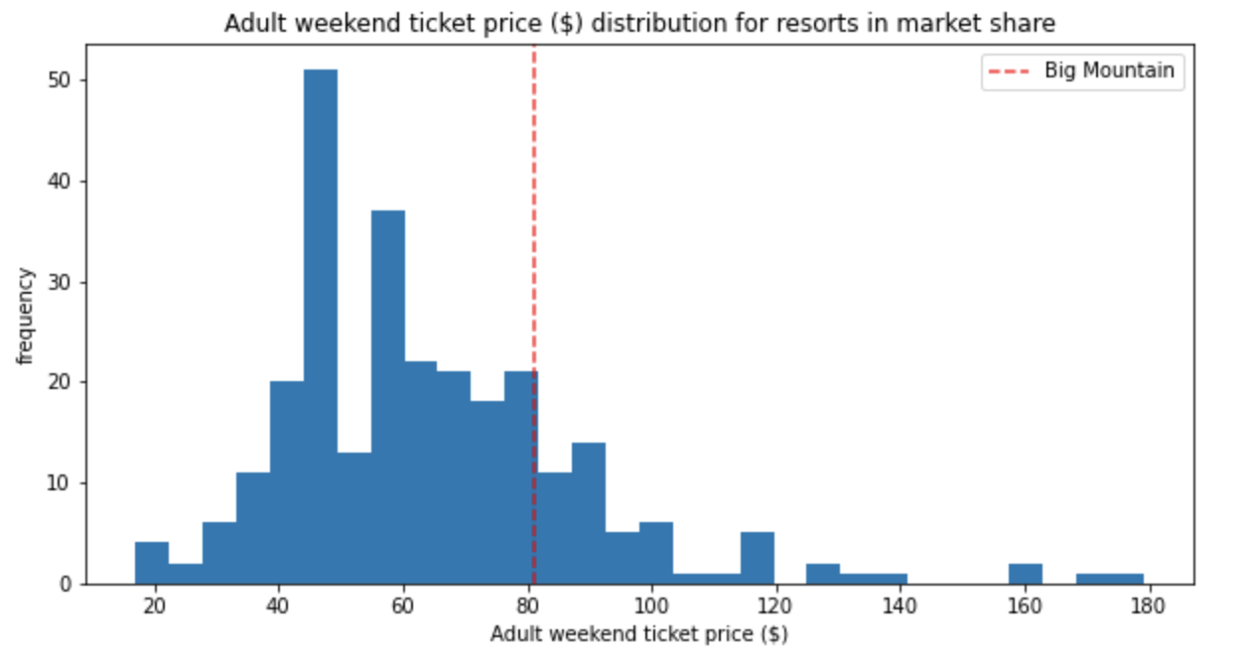
Big Mountain Ticket Price comparison in market

Slide 7
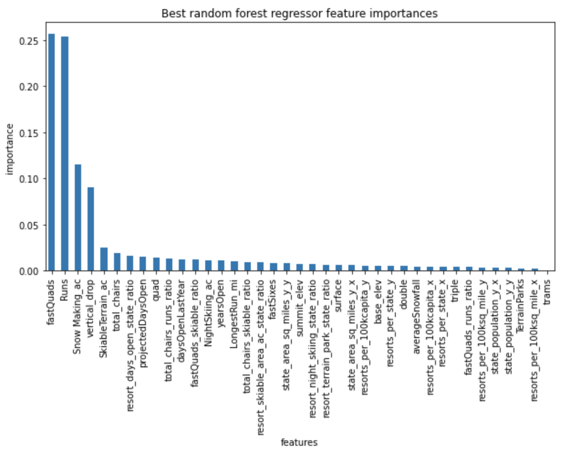
Bar graph of most relevant features/facilities

Slide 8
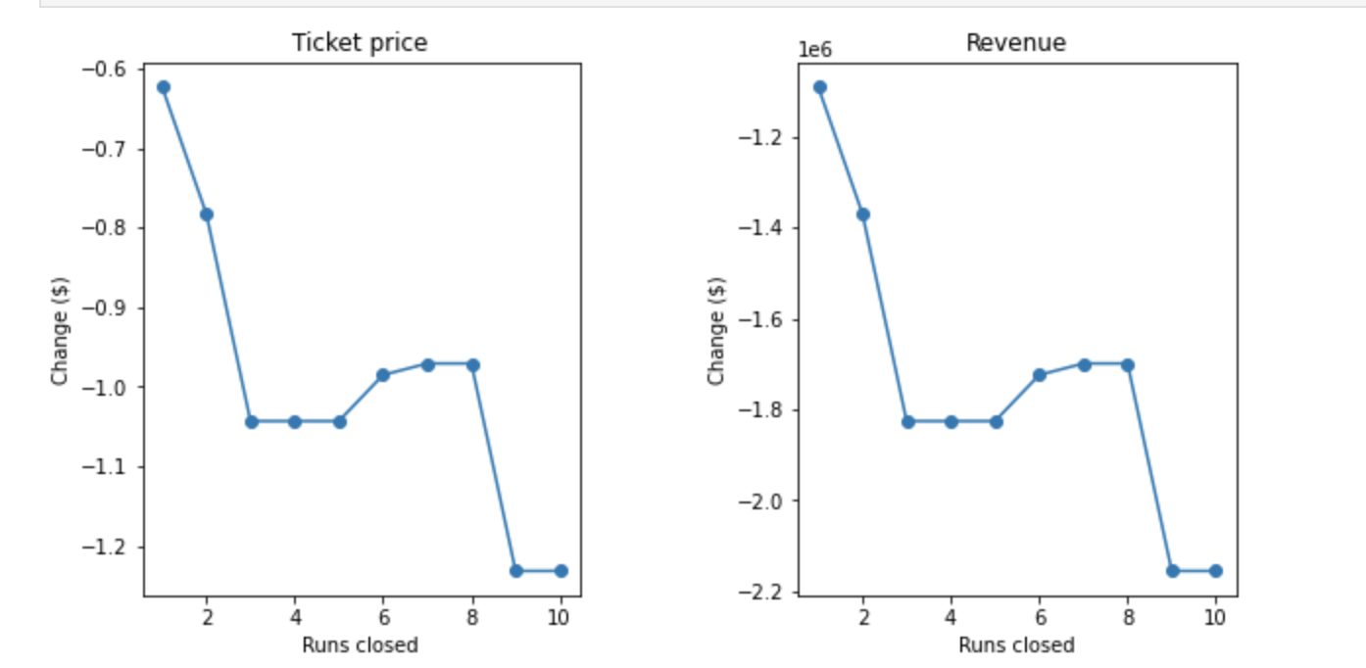
Effect of closing runs on ticket price and revenue

Slide 9
Effects of Scenarios 2-4 on ticket price and revenue
Scenario | Ticket Price Delta | Revenue Delta
2 | $1.74 | $3043478
3 | $1.74 | $3043478
4 | $0 | $0

Slide 10
Conclusion
The model suggests that Big Mountain is underpricing their tickets so the company can probably increase prices marginally with a disproportionately smaller penalty
There are only a handful of important facilities that are most relevant to affecting ticket prices, around 8
The company should consider closing down the least used run and enacting Scenario 2
The model’s scope is only the dataset provided so model results should be accompanied by domain knowledge and business knowledge during decision making

